Slide 1
Guest Lecture Stanford ME469: Nalu Overview
Stefan P. Domino
Computational Thermal and Fluid Mechanics
Sandia National Laboratories SAND2018-4619 PE

Slide 2
Nalu Overview: Outline
Nalu Technology Origination: ASC
Beyond the 32-bit Limit
Supported Physics
Supported Numerics
Low- and High-order
Moving Mesh (Sliding and Overset)
Multiphysics:
Fluid Structure Interaction
Conjugate Heat Transfer (CHT)
Participating Media Radiation
Conclusion

Slide 3

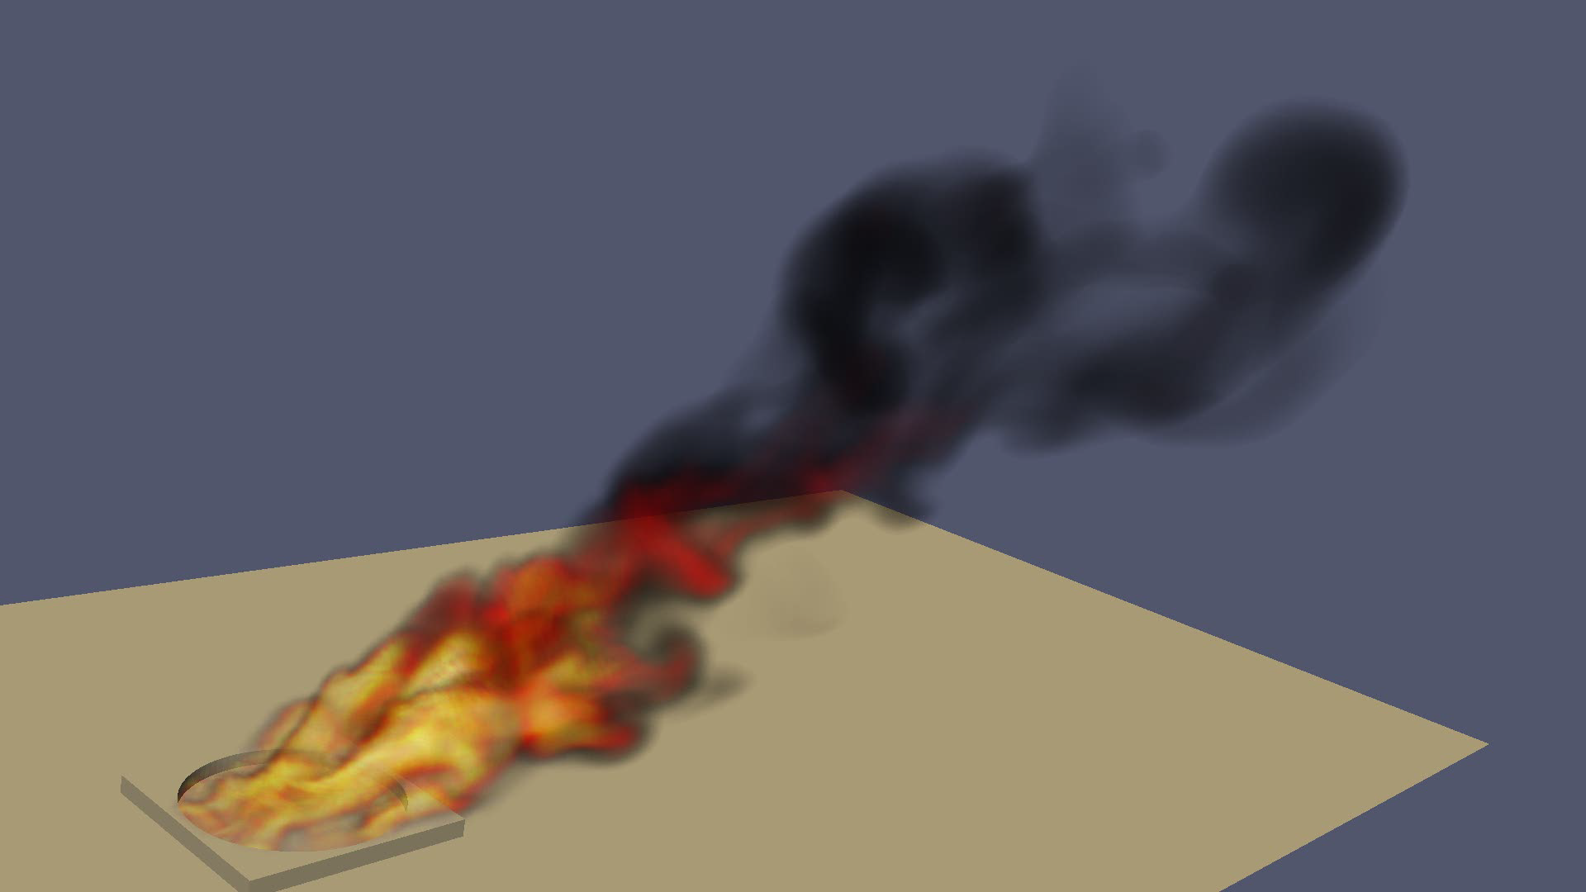
Core Technology Provided to Nalu Origination: Advanced Simulation and Computing Sierra/Fuego
Use-case characterized by a highly sooting, turbulent, reacting flow with Participating Media Radiation (PMR), Conjugate Heat Transfer (CHT), and propellant mutiphysics coupling
Complex geometry has driven a generalized, hybrid unstructured discretization approach supporting Hex8, Tet4, Wedge6, and Pyramid5 elements in addition to arbitrary promotion of Hex8 to Hex27, Hex64, etc.

Slide 4
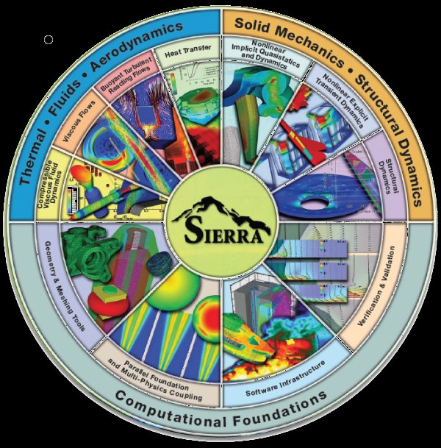


Goal: Beyond 32-bit Computing
Circa 2013, many scientific production codes were limited to 32-bit
Therefore, maximum simulation size for entities, e.g., node, edge, face, element, etc., was ~2.2 billion
Next Generation Platforms were advocated to overcome poor MPI scaling and power needs to support Exascale computing (10¹⁸ floating point operations/second)
Platform architectures are not yet known
+ ASC IC
Investments
( )
Sierra Toolkit/Trilinos (open-source)
MPI+X parallelism
Support for new architectures

Slide 5
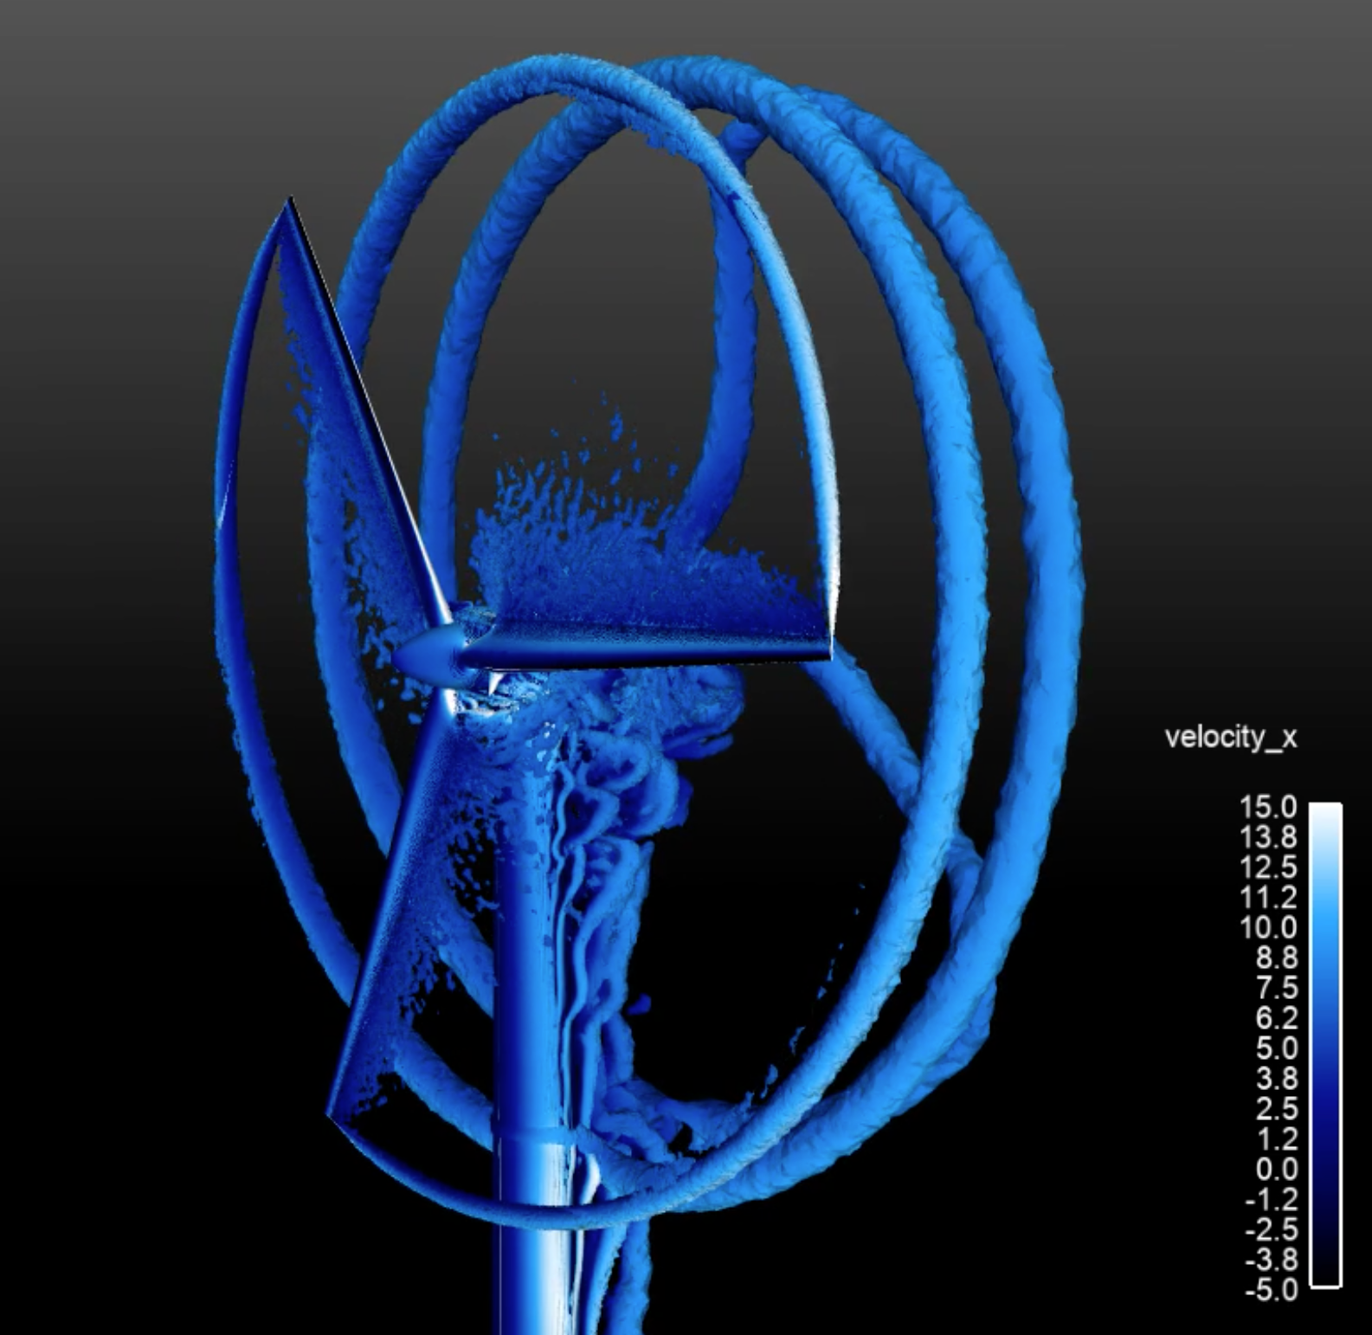
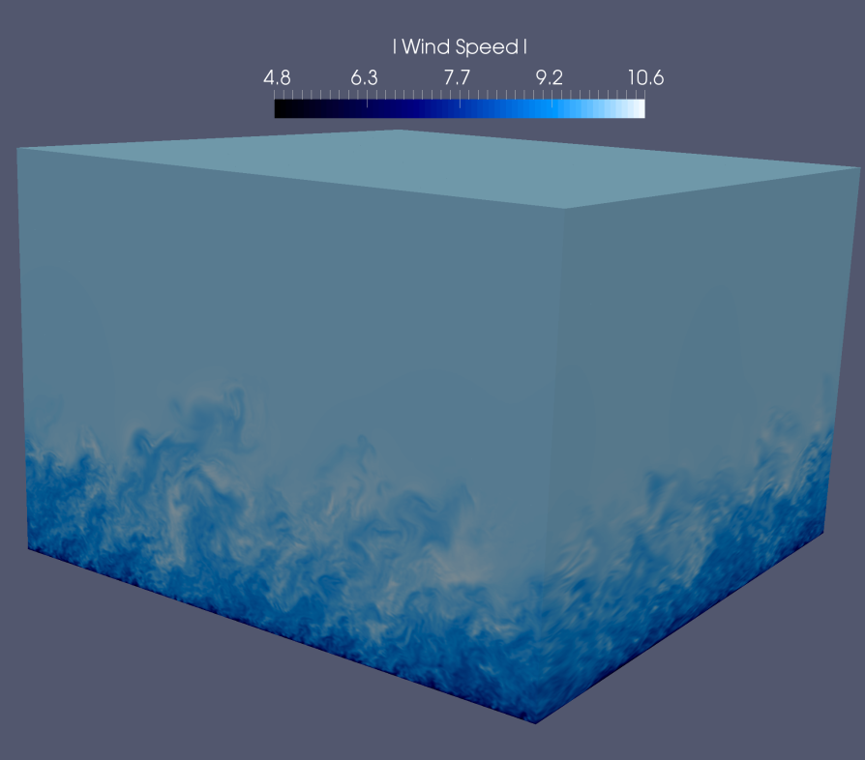
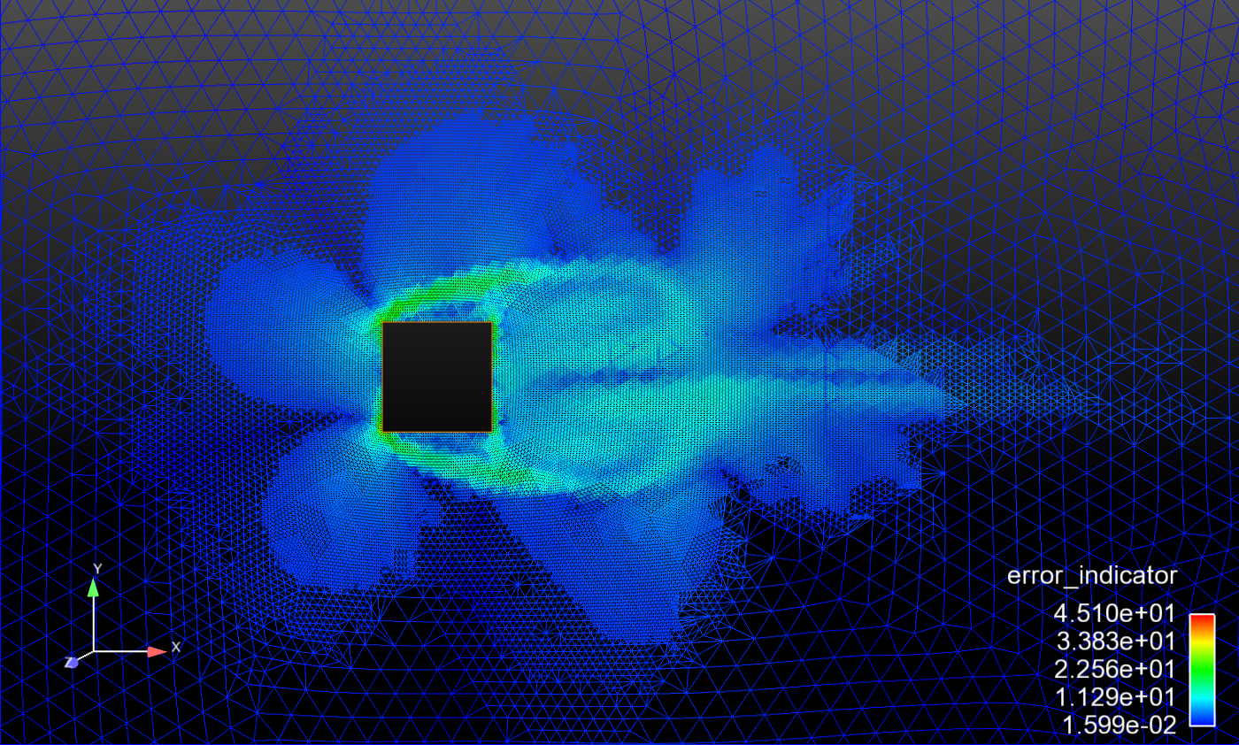
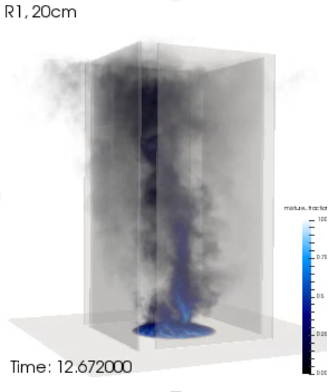
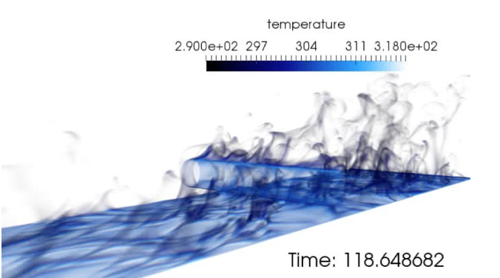
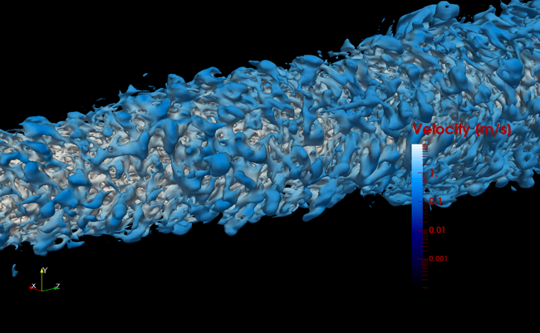
Supported Physics

Slide 6
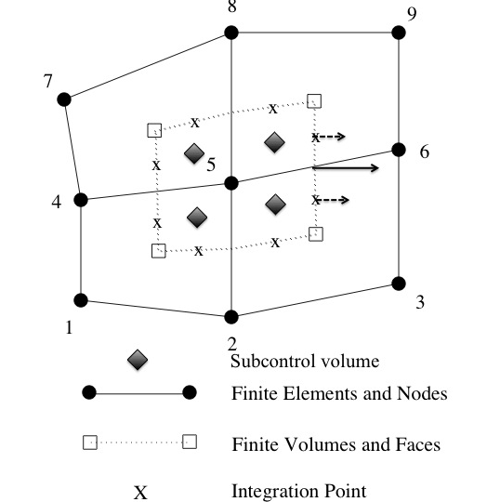
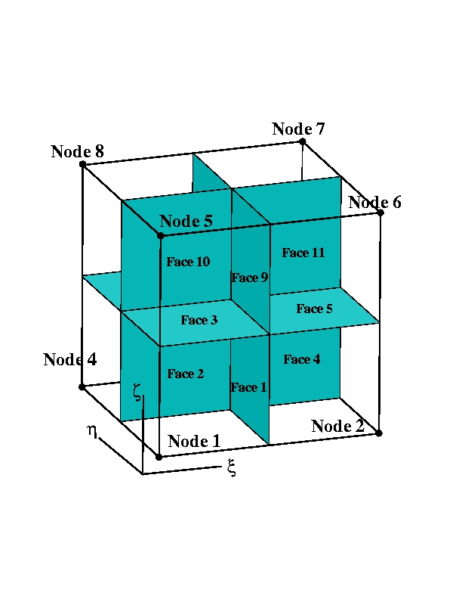
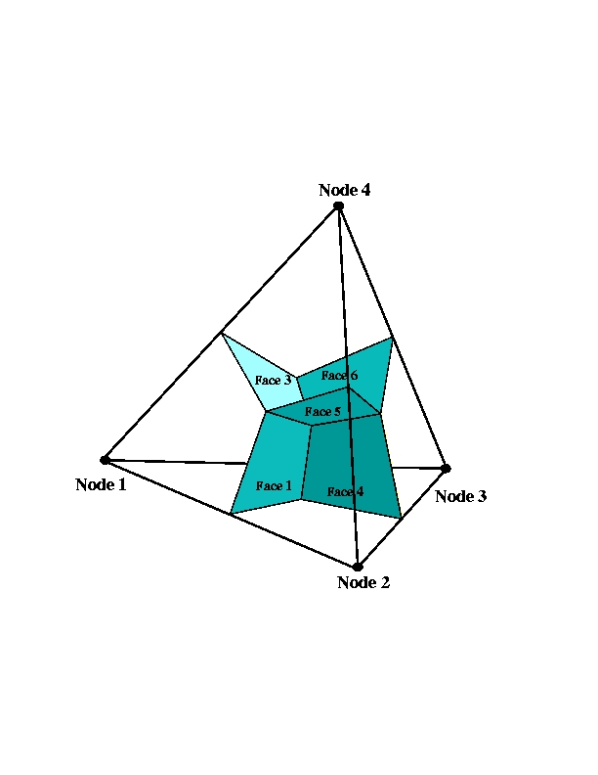
Supported Discretizations: CVFEM/FEM/EBVC
The core discretization used in the low Mach code base has been the Control Volume Finite Element Method, CVFEM
Finite Element Method and Edge-based Vertext Centered, EBVC, are also supported

Slide 7
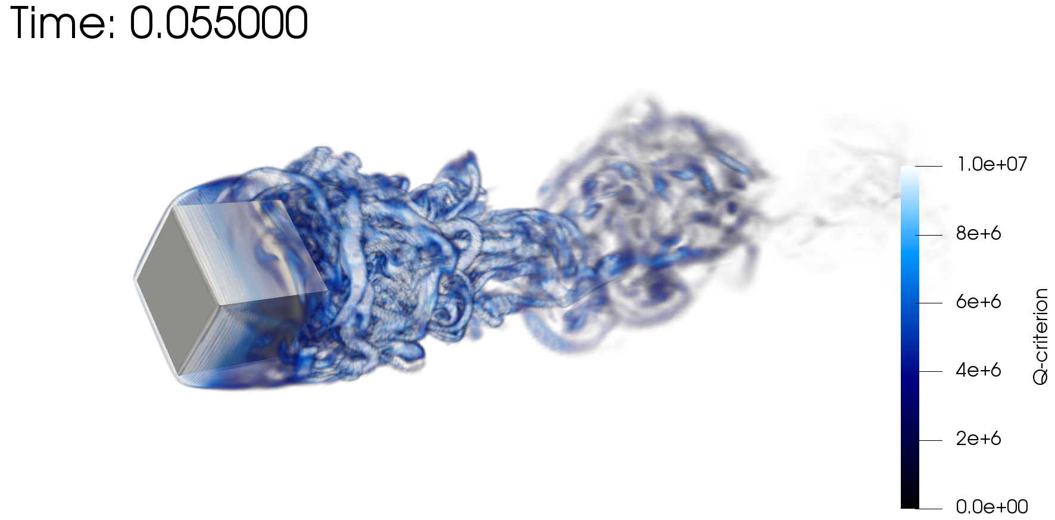

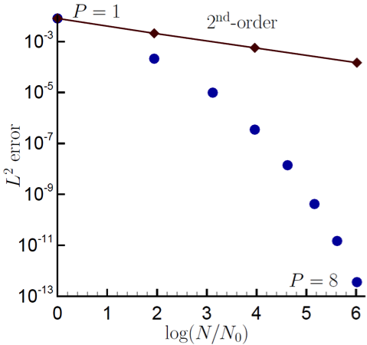
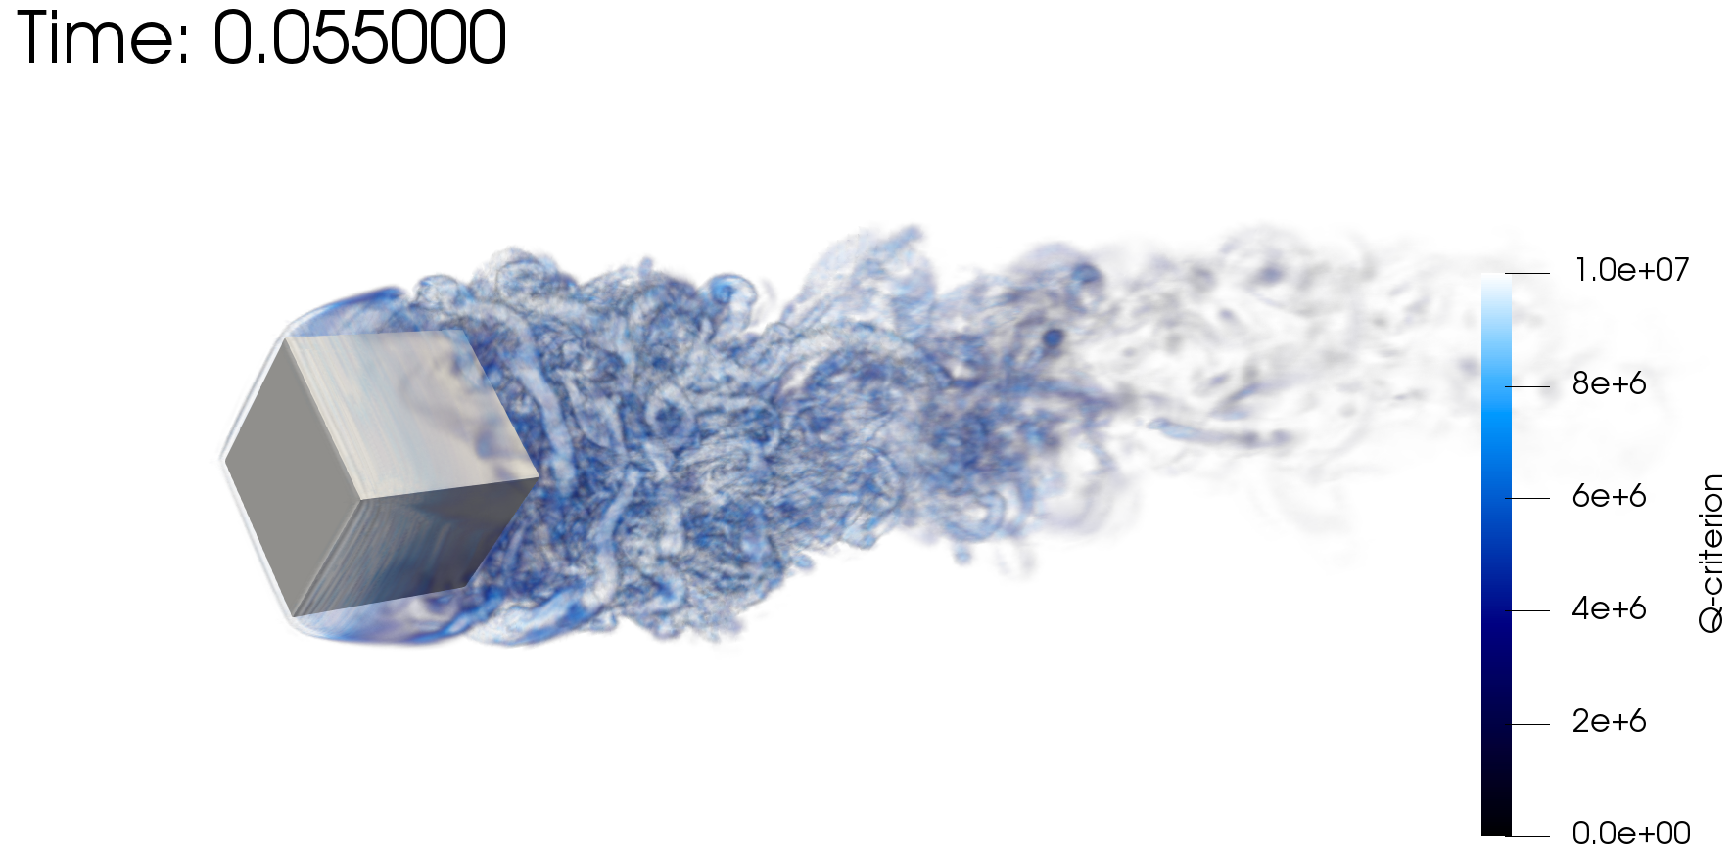
Scientific Research Platform to Evaluate Higher-Order Methods on Next Generation Platforms
As the cost of parallel assembly increases, should we strive to perform more local work? Higher-order achieves this design-point (at the cost of a larger memory footprint)
Spectral convergence
Dual-volume
for promoted quad4
Flow-past rotating cube
Re~4000, RPM~3200
Same node count,
P=1 (top) P=2 (bot)

Slide 8
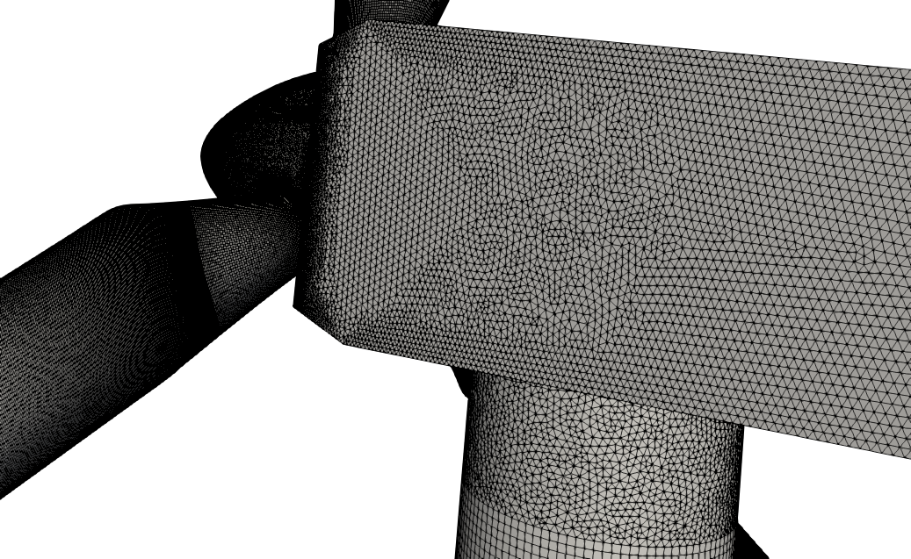
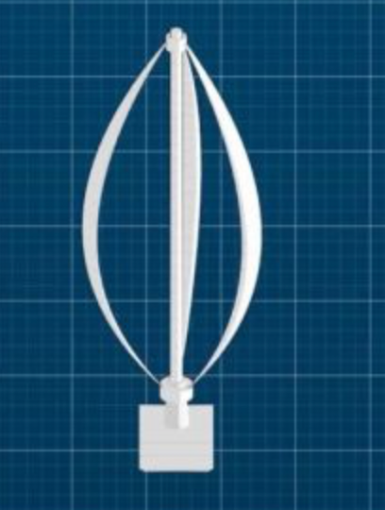
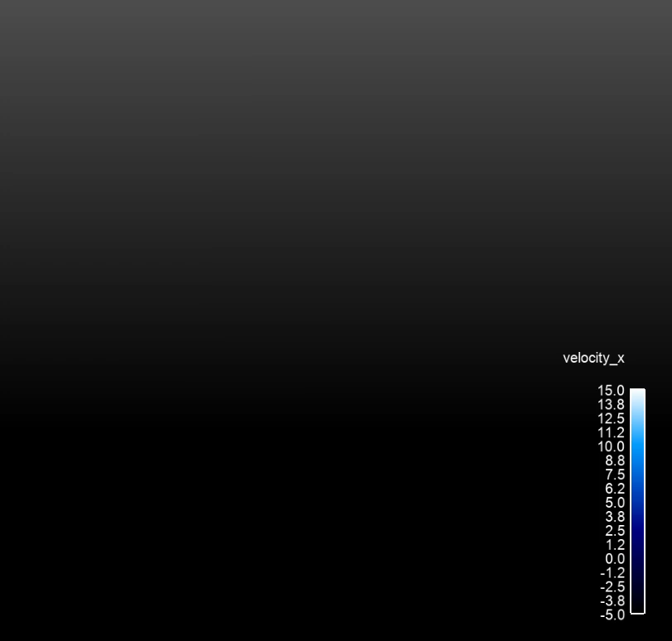

Unique Wind Energy Needs
Low-dissipation methods with suitable nonlinear stabilization operators to perform blade-resolved physics
Complex rotating blades, pitching blades, with possible yaw
Transition from low-order (near the blade) to higher-order (in the wake)
Generalized, unstructured, hybrid low-order simulations shown
Horizontal Axis Wind Turbine
(HAWT)
Vertical Axis Wind Turbine
(VAWT)

Slide 9
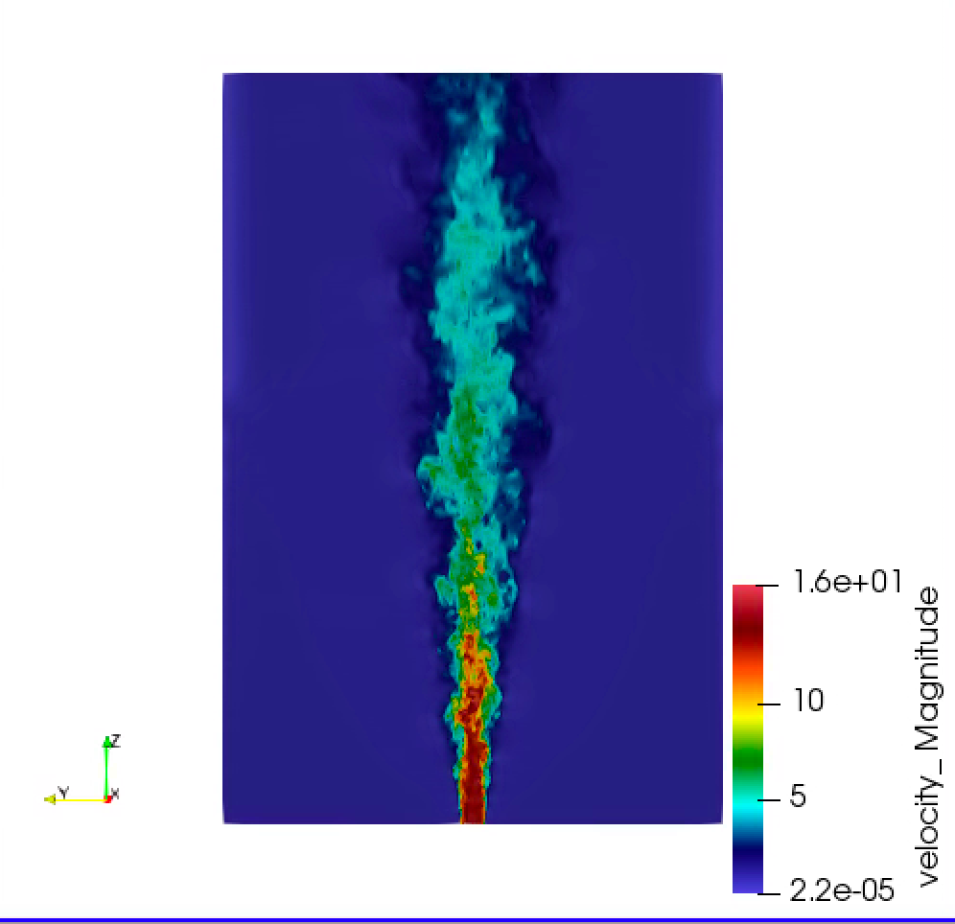


Developed Open-Source BSD-clause 3 Distribution Policy
Philosophy: Open-source collaborations
https://github.com/NaluCFD

Slide 10
Nalu Overview: Conclusion
Nalu’s technology has its roots in the ASC Sierra/Fuego effort
Multi-physics capabilities are in development
Research platform for high-order low-Mach methods
Open-source collaboration model
Funded through ASC, ECP, A2e, ASCR, and LDRD

